Slide 1

Automotive Technology: A Systems Approach, 8e
Chapter 33: Emission Control Systems
Rob Thompson and Jack Erjavec, Automotive Technology: A Systems Approach, 8th Edition. © 2025 Cengage. All Rights Reserved. May not be scanned, copied or duplicated, or posted to a publicly accessible website, in whole or in part.

Slide 2
Chapter Objectives
33.01 Describe the gases and pollutants present in engine exhaust.
33.02 List common types of emission control devices.
33.03 Describe the operation of an evaporative control system.
33.04 Describe precombustion emission controls.
33.05 Describe postcombustion emission controls.
33.06 Describe the emission controls commonly found on today’s light-duty diesel engines.

Slide 3
Pollutants (1 of 2)
33.01 Describe the gases and pollutants present in engine exhaust.
Automotive emissions that are of the most concern to environmentalists, engineers, manufacturers, and technicians are hydrocarbon (HC), carbon monoxide (CO), oxides of nitrogen (NOx), carbon dioxide (CO₂), and oxygen (O₂).
These gases contribute to air and water pollution and climate change.
The exception to this is O₂, which is not a pollutant.
Oxygen emissions are, however, an indication of the completeness of the combustion process.
The O₂ content in an engine’s exhaust also is monitored during emissions inspections to detect holes in the exhaust pipes or broken pipes.
An exhaust gas that is not monitored in most emissions testing is sulfur dioxide (SO₂).
It is caused by large amounts of sulfur content in gasoline and is produced by the action of the catalytic converter.

Slide 4
Pollutants (2 of 2)
Hydrocarbons
  Hydrocarbon (HC) exhaust emissions are caused by incomplete combustion, and these emissions are actually molecules of unburned or partially burned fuel.
  Even an engine in good condition with satisfactory ignition and fuel systems will release some HC.
  Evaporative emissions from the fuel storage and delivery system are also a source of HC emissions.
Nitrogen Oxides
  Nitrogen oxides (NOx) are the various compounds of nitrogen and O₂ formed during the combustion process.
  Both nitrogen and O₂ are present in the air used for combustion.
  Exposure to NOx can cause respiratory problems, such as lung irritation, bronchitis, or pneumonia.
  Photochemical smog results when HCs and NOx are combined with sunlight.

Slide 5
Knowledge Check (1 of 2)
Which harmful exhaust gas is caused by incomplete combustion?

Slide 6
Knowledge Check Answer (1 of 2)
  Answer: Hydrocarbons or HC

Slide 7
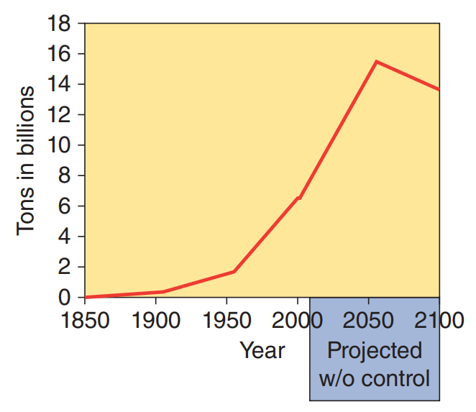
Carbon Dioxide
Carbon dioxide (CO₂) is not a pollutant; however, it has been linked to another environmental concern—the “greenhouse effect.”
Carbon dioxide is a greenhouse gas and may be a cause of global warming.
To bring the amount of CO₂ in the atmosphere to an acceptable level, we need more plant life, and we need to reduce the amount that is released to the atmosphere.
A target for reducing CO₂ is the automobile.
There are approximately one billion automobiles on the world’s roads and produce close to 20 percent of the world’s total CO₂ emissions from burning fossil fuels.

Slide 8
Diesel Emissions
Diesel engines are the most efficient of all internal combustion engines.
They have low fuel consumption rates and produce low amounts of greenhouse gases.
However, there are exhaust emissions that are of concern.
Some of these are currently regulated and others will be in the future.
A typical diesel engine emits:
  Carbon (soot) and various carbon-based compounds, NOx, water, carbon monoxide, sulfur dioxide, and various hydrocarbon-based compounds.
Soot is the most obvious emission and is often referred to as diesel particulates.
Particulate emissions are the main obstacle for using diesel engines in passenger cars and light- and medium-duty trucks. California and other states have set a standard for particulate emissions.

Slide 9
Emission Control Devices
33.02 List common types of emission control devices.
According to a recent document based on a study by the Environmental Protection Agency (EPA), passenger cars are responsible for 17.8 percent of the total hydrocarbon emissions, 30.9 percent of the total carbon monoxide emissions, and 11.1 percent of the oxides of nitrogen emissions.
After more than 40 years of emission regulations, these figures remain staggering.
Emission standards have been one of the driving forces behind many of the technological changes in the automotive industry.
Catalytic converters and other emission systems were installed to meet emission standards.
These standards have become progressively more stringent through the years, and the engine designs and devices required to meet the standards have become very complex.

Slide 10
Inspection and Maintenance Programs
Emission standards set the maximum allowable amounts of emissions from a new automobile.
These standards have become stricter through time.
Amendments to the acts called for emission testing of vehicles on the road.
These periodic tests are part of the inspection and maintenance (I/M) program.
The purpose of these inspections is simply to identify those vehicles that have been tampered with or have not received good maintenance.
Studies have shown that 20 percent of the vehicles on the road are not being properly maintained, and those vehicles account for more than 90 percent of the emissions from automobiles.
I/M programs are designed to identify these vehicles and make the necessary repairs to allow those vehicles to have acceptable amounts of emissions.

Slide 11
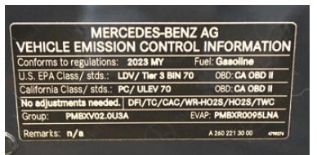
Vehicle Emission Control Information (VECI)
All vehicles have a vehicle emission control information (VECI) decal that gives specific emission control information for that vehicle and engine.
These decals are normally located on the underside of the hood or on the radiator support frame.
The information contained on the VECI is important when conducting an I/M test and when diagnosing or repairing an emissions-related problem.
Most of the information contained on the decal is expressed by acronyms.

Slide 12
Classifications of Emission Control Devices
All emission control systems fall into one of three classifications: evaporative control systems, precombustion, and postcombustion.
Most pollution control systems used today prevent emissions from being created in the engine, either during or before the combustion cycle.
The common precombustion control systems are the PCV, engine modifications, spark control, and exhaust gas recirculation (EGR) systems.
Postcombustion control systems clean up the exhaust gases after the fuel has been burned.
Secondary air or air injector systems put fresh air into the exhaust to reduce HC and CO to harmless water vapor and carbon dioxide by a chemical (thermal) reaction with oxygen in the air.
Catalytic converters are the most effective postcombustion emission control; they reduce NOx , HC, and CO emissions.

Slide 13
Evaporative Emission Control Systems
Fuel vapors from the gasoline tank and the carburetor float bowl were brought under control with the introduction of EVAP systems.
These systems were first installed in 1970 model cars sold in California.
Through the years, EVAP emissions have been closely monitored and the control systems modified to minimize the chances of vapors entering the atmosphere.
EVAP emissions are limited by law, and the current limit in the United States is 2 grams of HC per hour.
Current systems are computer controlled and are monitored by the OBD II system.
Most current EVAP systems include the following components:
Domed fuel tank, Canister vent solenoid valve, A special filler design to limit the amount of fuel that can be put in the tank, Fuel tank vacuum or pressure sensor, Fuel lines, Vapor lines, Fuel tank cap, A vapor separator in the top of the fuel tank, Charcoal (EVAP) canister, Purge lines, and Purge solenoid valve (vapor management valve).

Slide 14
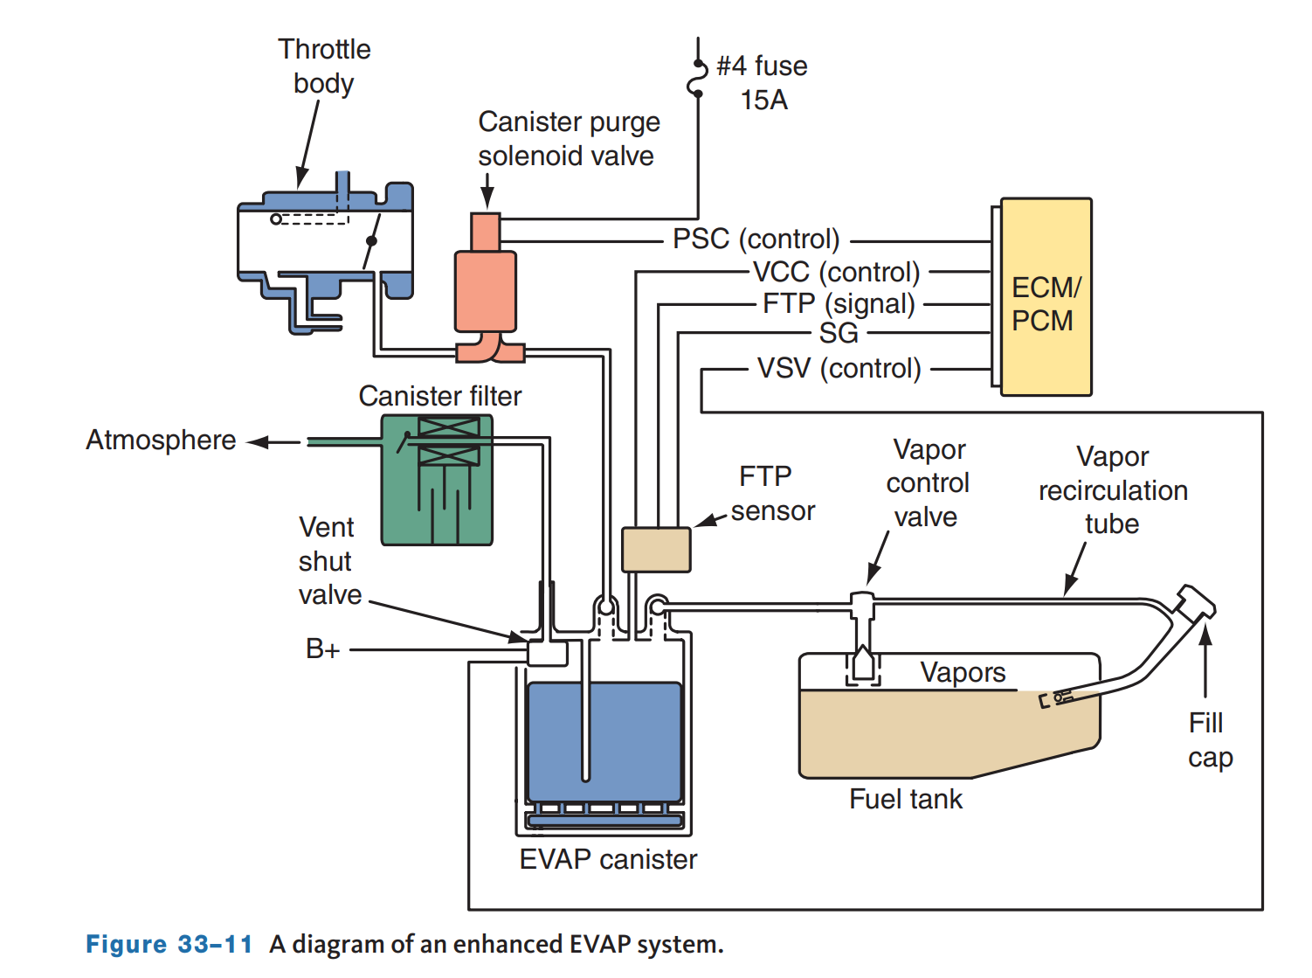
Enhanced Evaporative Emission (EVAP) System
33.03 Describe the operation of an evaporative control system.
To meet OBD II regulations, late-model vehicles have an enhanced EVAP system.
Enhanced EVAP systems operate in much the same way as previous PCM-controlled EVAP systems, but they also conduct tests that can detect small, 0.020 inch (0.5 mm) system leaks and monitor canister purge flow.
These systems have a fuel tank pressure (FTP) sensor and EVAP canister vent (CV) solenoid in addition to typical EVAP components.

Slide 15
Precombustion Systems
33.04 Describe precombustion emission controls.
Systems designed to prevent or limit the amount of pollutants produced by an engine are called precombustion emission control devices.
Although there are specific systems and engine designs that are classified this way, anything that makes an engine more efficient can be categorized as a precombustion emission control device.

Slide 16
Engine Design Changes
The basic engine has been modified through the years to increase its overall efficiency.
The result of these changes is improved performance and driveability and a decrease in exhaust emissions.
The following is some of those changes:
  Better sealing pistons
  Combustion chamber designs
  Lower compression
  Higher compression
  Decreased friction
  Intake manifold designs
  Improved cooling systems
  Spark control systems

Slide 17
PCV Systems
During combustion some unburned fuel and other products of combustion leak past the piston rings and move into the crankcase.
This leakage is called blowby. Blowby gases are largely HC gases.
The PCV systems route the gases, which are mixed with outside air, into the engine’s intake.
From there the gases are drawn into the cylinders and burned.
PCV systems were installed on all cars beginning with the 1963 models.
Blowby must be removed from the engine before it condenses in the crankcase and reacts with the oil to form sludge.
Sludge, if allowed to circulate with engine oil, corrodes and accelerates the wear of pistons, piston rings, valves, bearings, and other internal parts of the engine.
Blowby also carries some unburned fuel into the crankcase.
If not removed, the unburned fuel dilutes the engine’s oil.
Blowby gases must also be removed from the crankcase to prevent premature oil leaks.

Slide 18
EGR Systems
The EGR system releases a sample of exhaust gases into the intake’s air–fuel mixture.
This lowers the peak temperature of combustion and therefore reduces the chances of NOx being formed.
The recirculated exhaust gas dilutes the air–fuel mixture. Because exhaust gas does not burn, this lowers the combustion temperature and reduces NOx emissions.
Driveability problems can result from having too much recirculated exhaust gas in the combustion chamber.
This is especially true when there is a high demand for engine power.
Also, poor control of EGR flow can cause starting and idling problems.
This is why EGR flow is disabled during cold starting, at idle, and at throttle openings of more than 50 percent.
Many late-model engines do not have an EGR system.
Rather, they rely on variable valve timing to prevent all of the exhaust gases from leaving the cylinder during the exhaust stroke during some operating conditions.

Slide 19
Intake Heat Control Systems
HC and CO exhaust emissions are highest when the engine is cold.
The introduction of warm combustion air improves the vaporization of the fuel in the fuel injector throttle body or intake manifold.
On older engines equipped with a throttle body injection (TBI) unit, the fuel is delivered above the throttles, and the intake manifold is filled with a mixture of air and gasoline vapor.
Some intake manifold heating is required to prevent fuel condensation, especially when the intake manifold is cool or cold.
Therefore, these engines have intake manifold heat control devices such as heated air inlet systems, manifold heat control valves, and early fuel evaporation (EFE) heaters.
A heated air inlet control may be used on engines with TBI.
This system controls the temperature of the air on its way to the throttle body.
Another system used is an exhaust manifold heat control valve that routes exhaust gases to warm the intake manifold when the engine is cold.

Slide 20
Postcombustion Systems
33.05 Describe postcombustion emission controls.
Postcombustion emission control devices clean up the exhaust after the fuel has been burned but before the gases exit the vehicle’s tailpipe.
An excellent example of this is the catalytic converter.
A converter is one of the most effective emission control devices on a vehicle for reducing HC, CO, and NOx .
Another postcombustion system is the secondary air or air injection system.
This system forces fresh air into the exhaust stream to cause a secondary combustion and reduce HC and CO emissions.

Slide 21
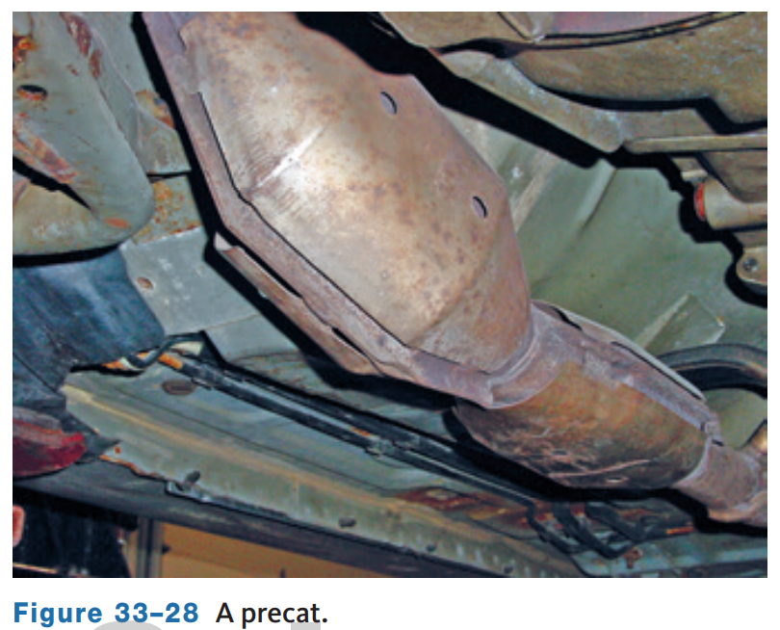
Catalytic Converters (1 of 2)
Today’s catalytic converters are extremely effective in reducing the amount of HC, CO, and NOx emitted from a vehicle’s tailpipe.
Most current vehicles have two converters in each exhaust stream.
If the engine has more than one exhaust manifold, there is an exhaust stream from each, and each of those streams has two converters.
The first converter is located close to the exhaust manifold. Because the effectiveness of a converter depends on its temperature, placing a converter close to the manifold allows it to warm up quickly.
These converters are called light-up or warm-up converters, or precats.

Slide 22
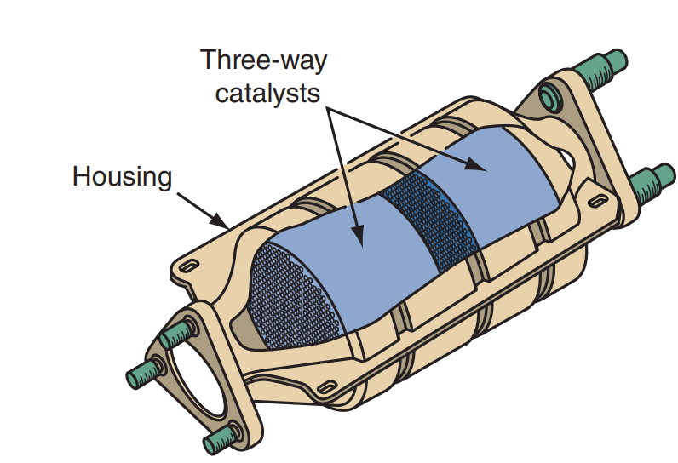
Catalytic Converters (2 of 2)
Prior to OBD II, catalytic converters contained two different types of catalysts: a reduction catalyst and an oxidation catalyst.
The two separate catalysts created a dual-bed converter.
Exhaust gases passed over the first or reduction bed where NOx emissions were eliminated.
Then the exhaust passed to the second where they were oxidized to eliminate CO and HC emissions.
All late-model vehicles use a three-way converter (TWC) that decreases HC, CO, and NOx emissions.
The catalyst used in the reduction bed is either platinum or rhodium.

Slide 23
Air Injection Systems
An air injection reactor (AIR) system was built into cars and light trucks sold in California in 1966 and used in all automobiles for several years.
The AIR system reduced the amounts of HC and CO in the exhaust.
The air caused combustion of the gases in the exhaust manifolds and pipes, thereby reducing the amount of the gases emitted from the tailpipe.
As manufacturers gained more control over emissions through engine design and advanced emission control systems, the purpose of the AIR system changed.
It became known as the secondary air injection system and was modified to allow catalytic converters to operate more efficiently.
The system injected air into the catalytic converter.
This helped the converter oxidize and reduce the gases entering into it.
AIR systems are not commonly used today.
Improved combustion and better catalytic converters have eliminated their need.

Slide 24
Discussion
There are many different emissions control devices and systems.
Have a class discussion while providing several examples of the system or device, how it works, and what harmful emission it is designed to decrease.

Slide 25
Diesel Emission Controls
33.06 Describe the emission controls commonly found on today’s light-duty diesel engines.
The use of cleaner fuels and new technologies, such as PCM-controlled fuel injection systems, allows today’s diesel engines to have emission levels that match those of gasoline engines.
Clean diesel exhaust is further possible because the vehicles can be fitted with EGR and PCV valves, catalytic converters, and particulate filters.
Technology has also allowed diesel engines to run quietly.
Today’s diesel engines are fitted with OBD systems similar to those found on gasoline engines.
These systems monitor the effectiveness of various emission-related devices, such as the fuel system, EGR system, catalyst, oxidation catalyst, particulate filter, and PCV system.
They also have misfire and comprehensive component monitors

Slide 26
Low-Sulfur Fuel
Legislation has required fuel suppliers to remove nearly all sulfur from most of the diesel fuel they produce for on-highway use.
Previously, up to 500 ppm were allowed.
The limit for 2007 and newer diesel engines is 15 ppm.
The use of this fuel not only reduces sulfur-related emissions, but it also allows diesel engines to be equipped with typically sulfur-intolerant exhaust emission controls, such as particulate filters and NOx catalysts.
This means diesel exhaust now has the capability to be as clean as that from a gasoline engine.

Slide 27
Diesel Fuel Injection
Most current light-duty diesel engines use a common rail injection system.
These systems use high pressure and this pressure is provided equally to all injectors.
This allows the PCM to precisely control and monitor the amount of fuel injected into the cylinders.
The introduction of highly pressurized fuel into the cylinders provides improved atomization of the fuel.
  This, along with precise timing, allows the engines to run cleaner and quieter.
Common rail systems use solenoid-operated or piezo-inline injectors.
The use of piezoelectric injectors increases the PCM’s ability to control injection timing. New common rail designs have injectors that are activated by hundreds of thin piezo crystal wafers.
Piezo crystals expand quickly when a current is applied to them.
The ability of these injectors to quickly respond also allows the PCM to control several injector firings in a single combustion stroke.

Slide 28
PCV System
Diesel engines emit crankcase gases just like gasoline engines.
However, control of these gases is much different in diesel engines because they produce very little vacuum and, therefore, conventional PCV systems do not work.
Vacuum is produced in a diesel engine in the opposite way as a gasoline engine—little to no vacuum at idle with an increase as engine speed increases.
Therefore, a conventional PCV system cannot work on a diesel engine.
Many diesel engines release these gases to the atmosphere through a crankcase breather or downdraft tube just like early gasoline engines.
Both are a source of HC and PM emissions and are undesirable.
Some systems have a PM filter that reduces those emissions but do not allow the engine to meet emission standards.
The industry has taken many different steps to control these emissions.
One of these steps is the installation of a multistage filter system that is designed to collect, coalesce, and return the emitted crankcase oils to the oil sump.

Slide 29
Catalytic Converters
The most common catalytic converter for diesel engines is an oxidation catalyst.
This converter uses the O₂ in the exhaust to oxidize CO to form CO₂ and oxidize HC to form H₂O and CO₂.
The converter also reduces the amount of soot.
Some engines are fitted with diesel particulate filters that capture the remaining soot.
To control NOx emissions, engines may also have a NOx adsorber catalyst built into the oxidation converter or as a separate unit.
This converter is comprised of an alkaline metal (typically barium) to store NOx and a NOx reduction catalyst.

Slide 30
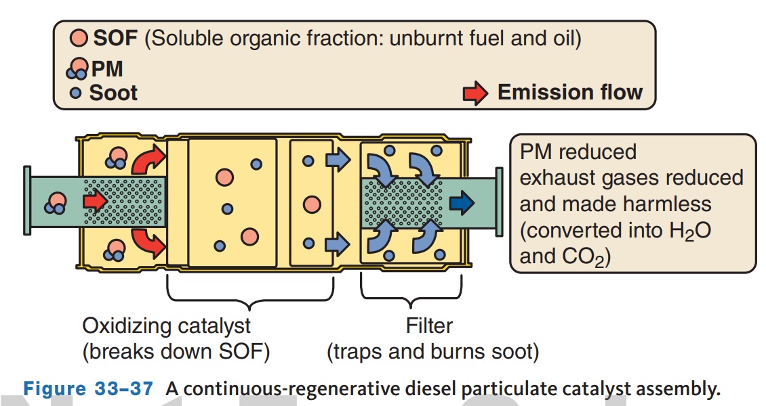
Particulate Filter
Soot can be controlled by running the engine on a lean mixture and using a high-pressure common rail injection system.
This brings soot emissions down significantly, as does the oxidizing catalytic converter. However, to meet EPA emission standards for PM emissions, late-model vehicles also have a particulate filter. Particulate filters are placed into the exhaust system after the catalytic converter.
Sometimes, the PM filter is part of the converter assembly.
Particulate filters are designed to trap PM.

Slide 31
Selective Catalytic Reduction (SCR) Systems
To reduce NOx emissions from a diesel vehicle, two separate technologies are used: selective catalytic reduction (SCR) and NOx traps or adsorbers.
Conventional reduction catalytic converters do not work well on diesel engines.
This is because the O₂ content in the exhaust is high, and their converters operate at a low temperature.
This means a reduction converter would not be very effective.
The common reductants used in SCR systems are ammonia and urea water solutions. The reductant is injected in the exhaust stream over a catalyst.
These special catalytic converters work well only when they are within a specific temperature range.
The engine’s control unit is programmed to keep the temperature of the exhaust within that range.
Also, the amount of reductant sprayed into the exhaust must be proportioned to the amount of exhaust flow.

Slide 32
Knowledge Check (2 of 2)
What is the purpose of a particulate filter?

Slide 33
Knowledge Check Answer (2 of 2)
Answer: The diesel particulate filter or DPF is designed to decrease particulate matter from the exhaust.

Slide 34
Chapter Reflection
Please take a moment to compare your perception of emissions systems before and after you studied this chapter. Then respond to the following questions in one or two paragraphs. Use 150–200 words in your reflection.
Were there any concepts in this chapter that you struggled to understand? What will you do to improve your understanding?
Which of the emissions control systems did you find the most difficult to understand? How will you increase your level of understanding of this system?

